Slide 1
Moser | DataJoint Imaging
Pipeline architecture and data ingestion
Thinh Nguyen - May 2021

Slide 2
What to get out of this session?
Overview of the imaging DataJoint pipeline
Core tables
What are stored where
How things flow
High level view of the ingestion routine
How your data make its way into the pipeline

Slide 3
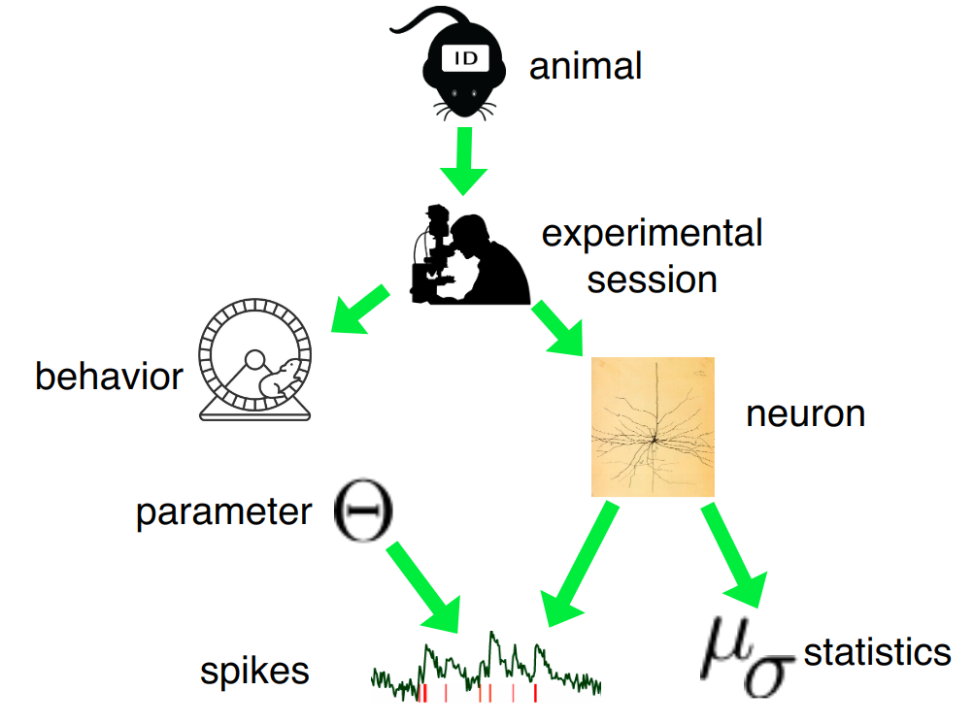



What are data pipelines
In the mind of the researcher...
https://moser-pipelines.readthedocs.io/en/latest/common/getting_started/why.html#
"Things", relationships between them,
execution steps
Scientific Data Pipeline

Slide 4
Why use data pipelines
Uniform and standardised way for data organization and management
Then we can automate processing/analysis consistently, and on scale
Data are structured - easy to search, query, restrict, download
Easy publishing
Easy to extent

Slide 5
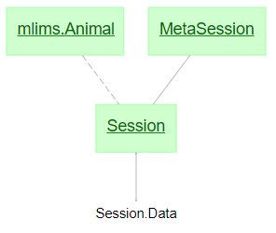
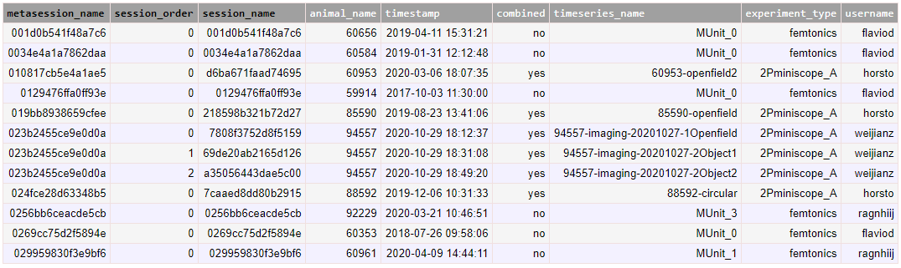
Imaging experiments
Data acquisition
In an experimental session
From an animal - from MLIMS
Meta information about the setup for this session
The acquired data
Imaging data - Femtonics or Miniscopes
Tracking data - Wheel, 2D, DLC
Sync data
Suite2p analysis
Summary images
Cells, traces, spikes
(MetaSession with 3 sessions)

Slide 6
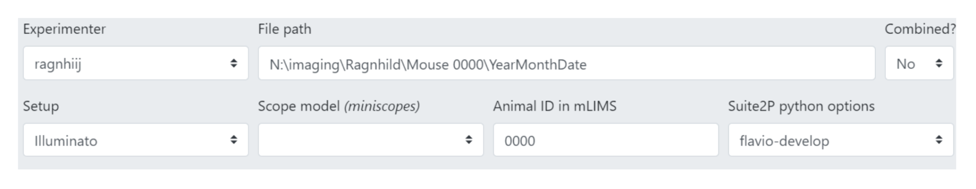
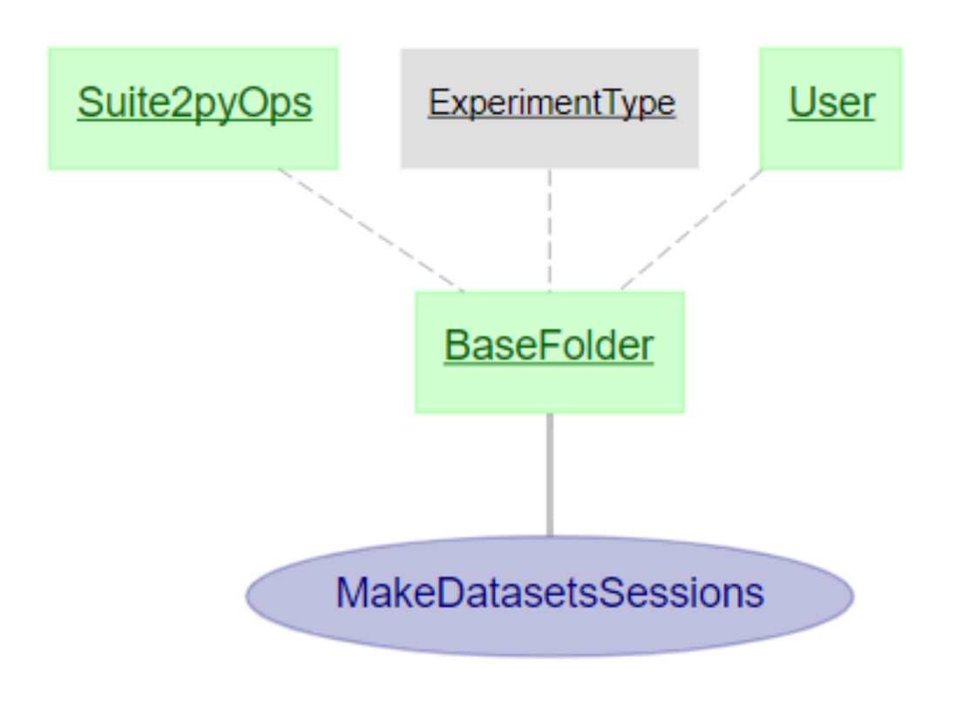
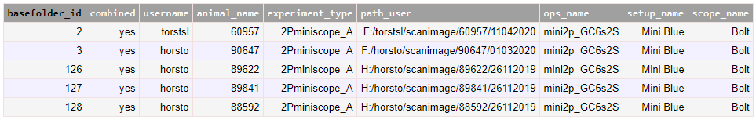

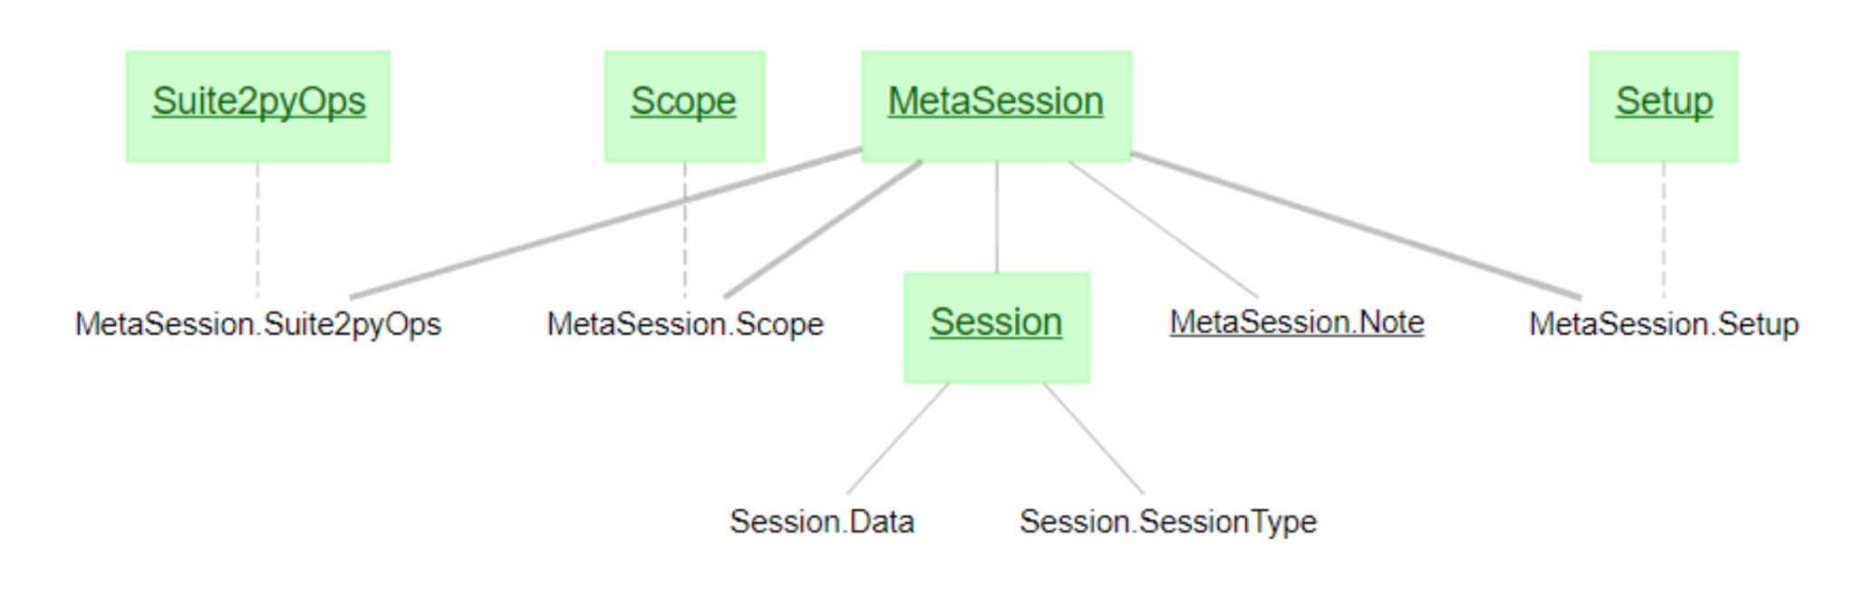
WebGUI Interaction
Moser | DataJoint Imaging WebGUI
Ingestion Schema
MetaSession & Session

Slide 7
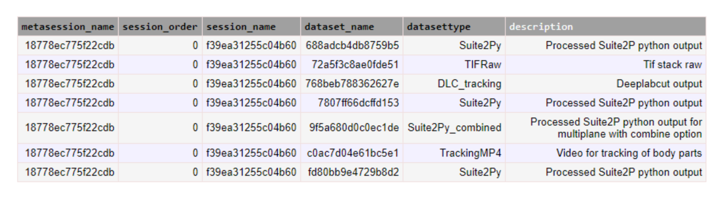
Ingestion routines
scan info, sync data
DeepLabCut tracking data
Cells, traces, spikes

Slide 8
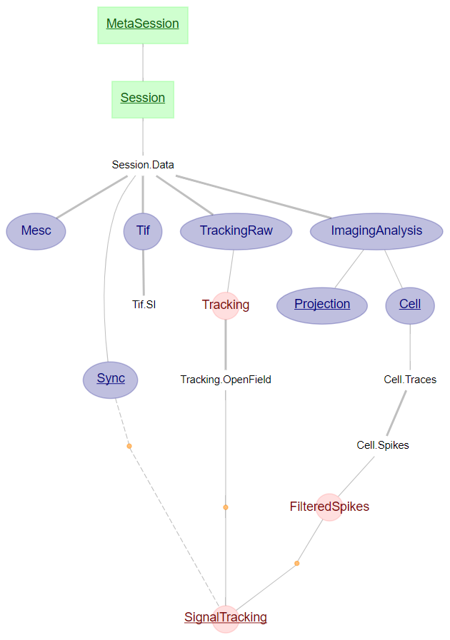
The main pipeline
Imaging meta information
Tracking data
Imaging analysis (cells, traces, spikes)

Slide 9
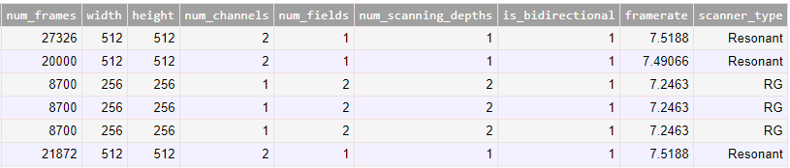
Imaging meta information
Imaging meta information
Tracking data
Tif and Tif.SI contents
Imaging analysis (cells, traces, spikes)

Slide 10
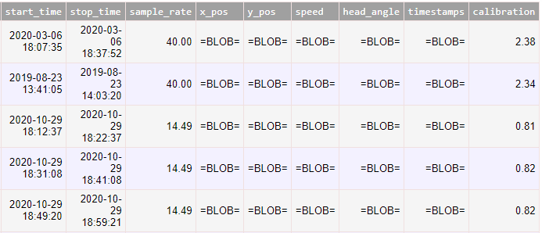
Tracking data
Imaging meta information
TrackingRaw, Tracking and Tracking.OpenField contents
Tracking data
Imaging analysis (cells, traces, spikes)

Slide 11
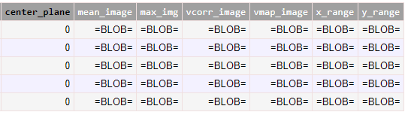
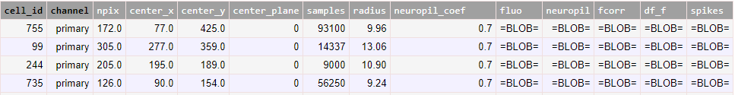
Imaging analysis
Imaging meta information
Tracking data
Imaging analysis (cells, traces, spikes)
Projection contents
Cell, Cell.Traces, Cell.Spikes contents

Slide 12
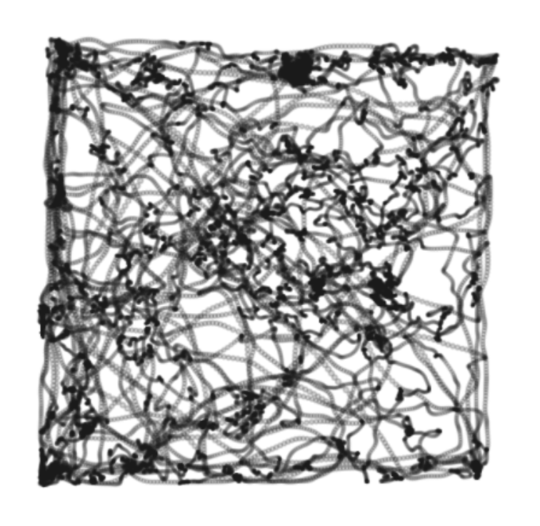
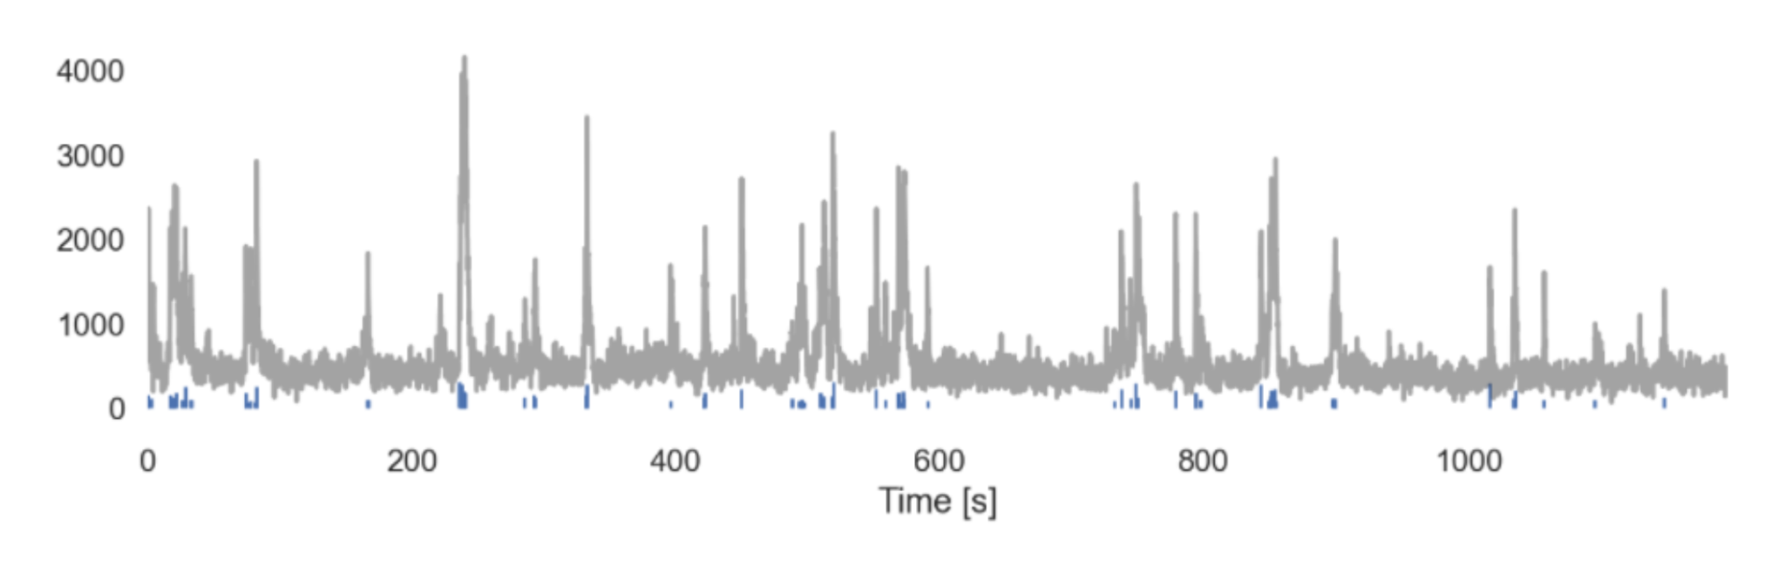
Tracking & Imaging analysis data

Slide 13
Points for discussion
Ways to use
Data repository to query and do whatever you want downstream
SessionView as screening tool
Can Suite2p, DLC analysis be done locally?
You can, and the pipeline would ingest the locally generated results too
But you don’t have to anymore
Imaging pipeline are designed to be flexible
New data type? - Just need to build a new “loader”
New data modality? - Extend new table(s) downstream
Generalized design for tables to fit many things (Tif, ImagingAnalysis)
Tif - extend beyond ScanImage?
ImagingAnalysis - using other analysis package other than Suite2p?

Slide 14
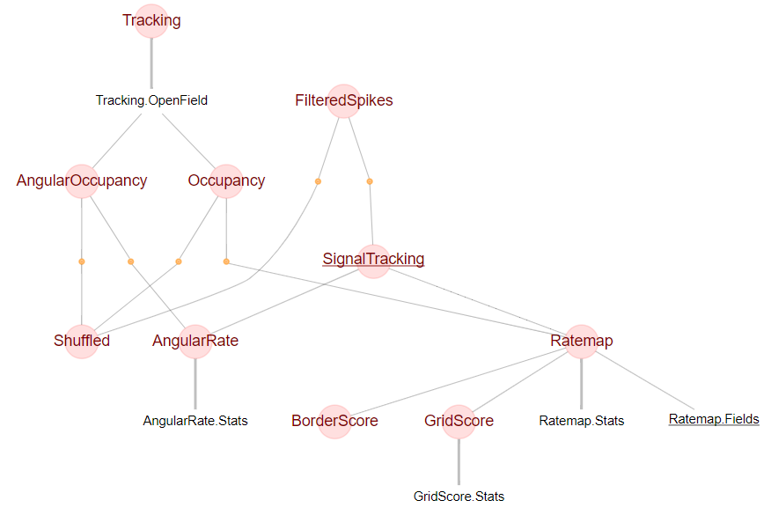

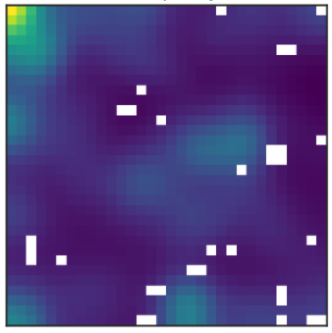
Downstream
analysis

